Slide 1
TTÜ logoga seinakellad
Marina Lagun
178525 EDTR

Slide 2
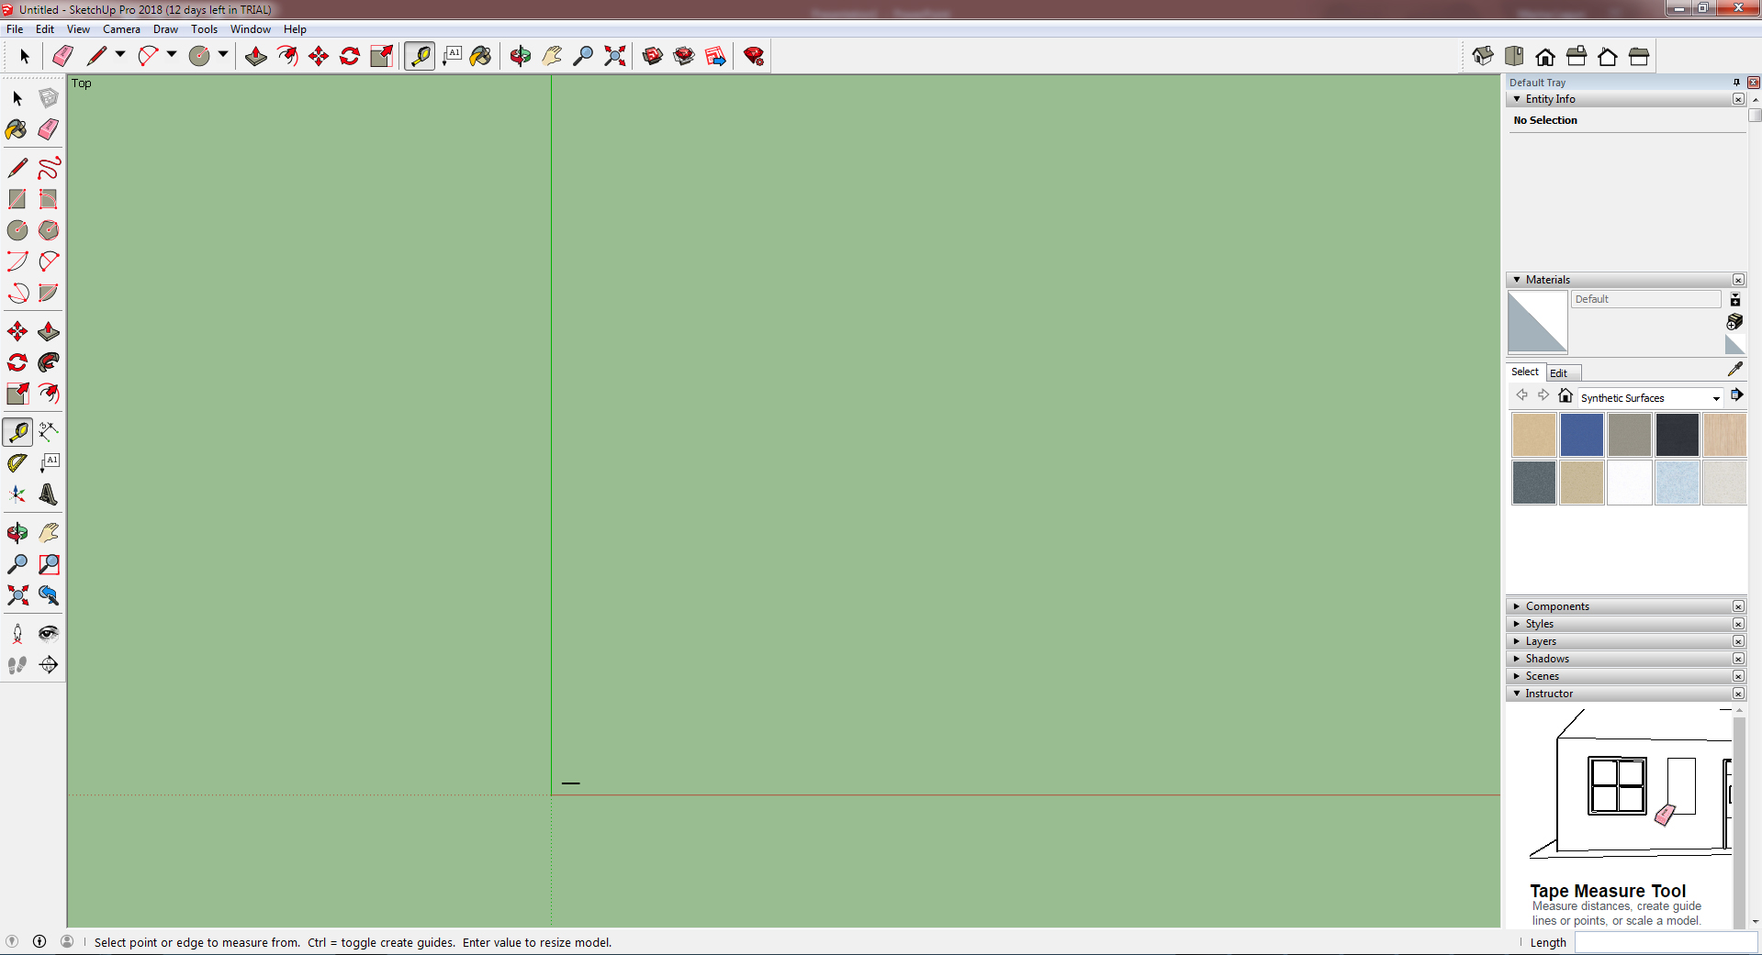
Notes:
Camera -> Standard Views -> Top
Camera -> Parallel Projection

Slide 3
Notes:
Draw circle with 15 cm radius

Slide 4
Notes:
Offset tool, inner offset, 1,5 cm distance

Slide 5
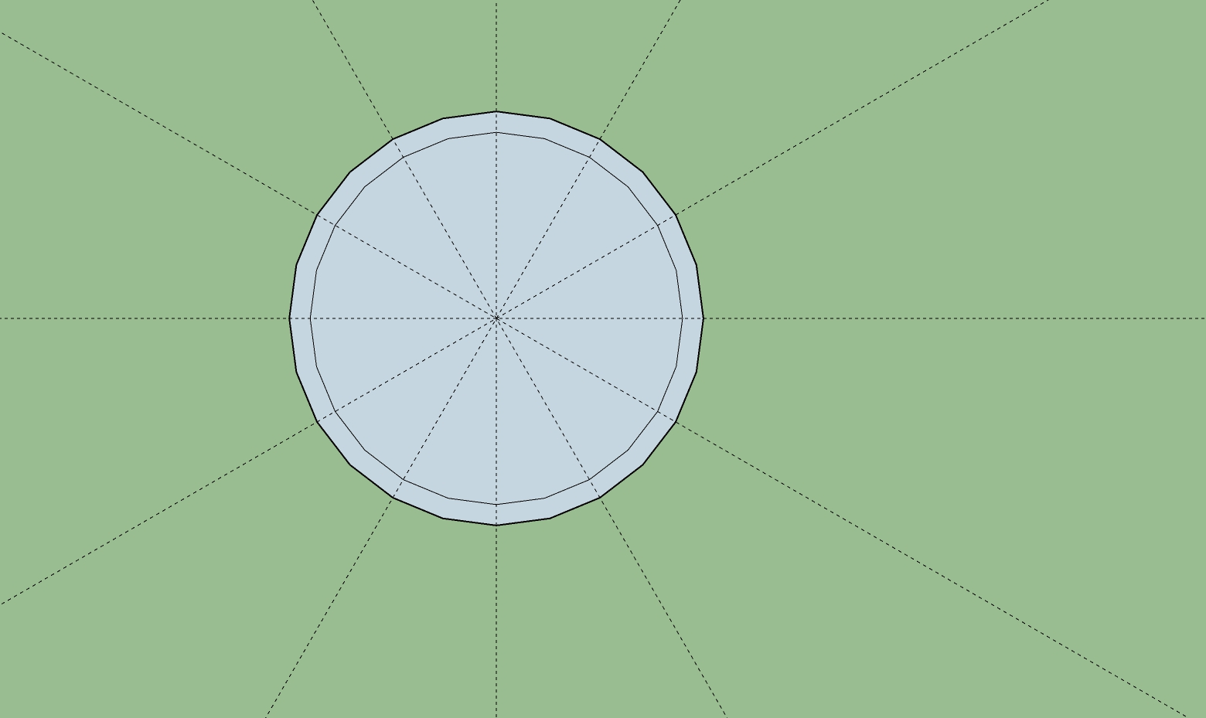
Notes:
Using Tape Measure Tool draw guides for drawing clock faces

Slide 6
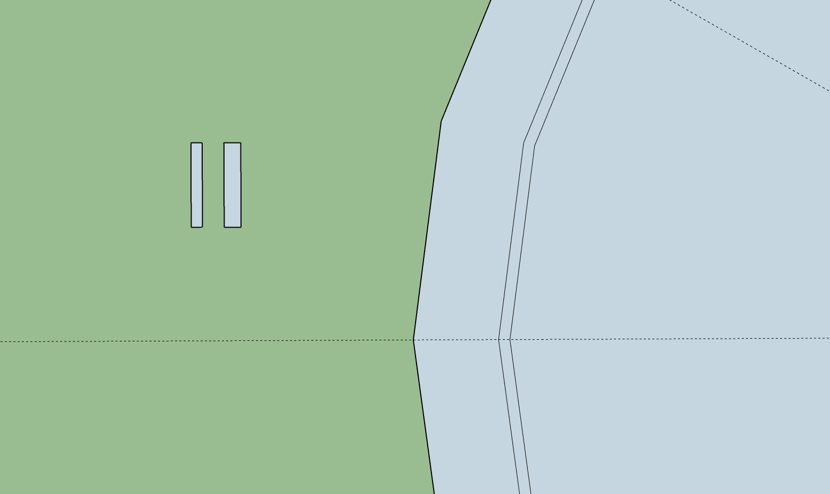
Notes:
Draw another Inner offset 0,2 cm wide. Draw two rectangles, one is 1,5 by 0,2 cm, and second 1,5 by 0,3 cm. With Select tool triple click on one’s rectangle’s face, then click right mouse button and select Make Group. Repeat steps for second rectangle.

Slide 7
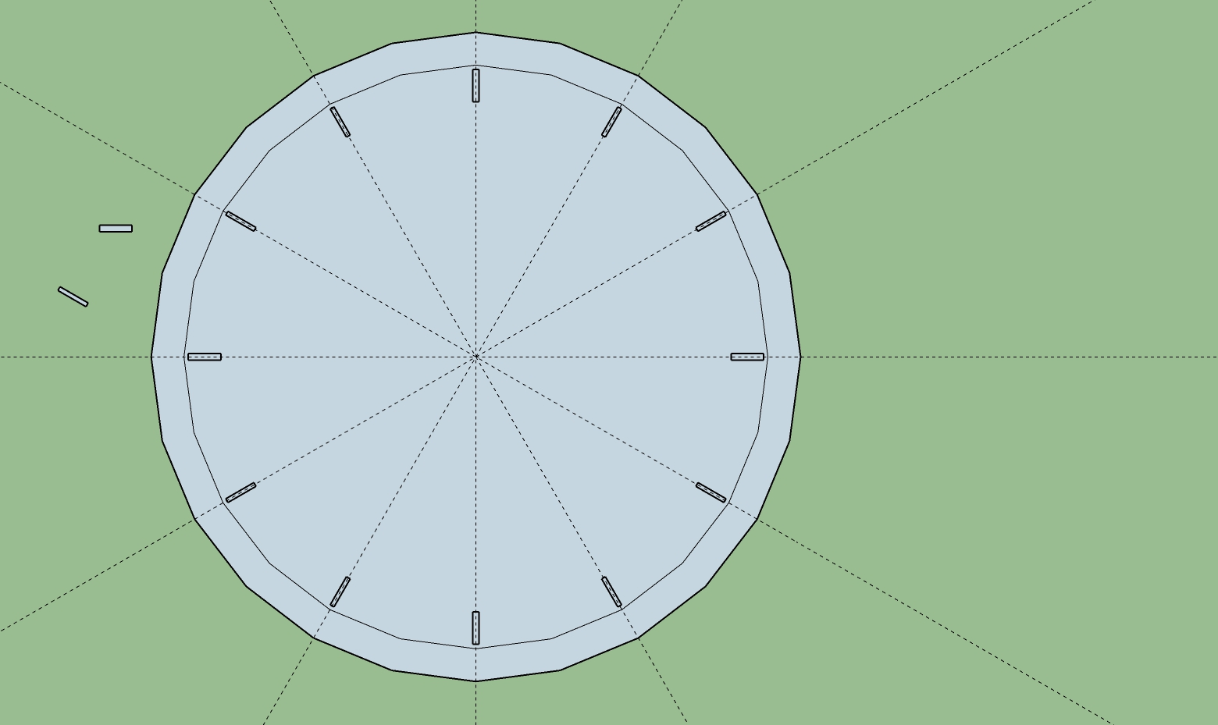
Notes:
Select Move tool, press Ctrl and move mouse to the midpoint of rectangles, then move its copy to its proper place. Rotate rectangles with Rotate tool by 90 or 30 degrees to adjust them properly. Delete innermost offset and any leftover rectangles..

Slide 8
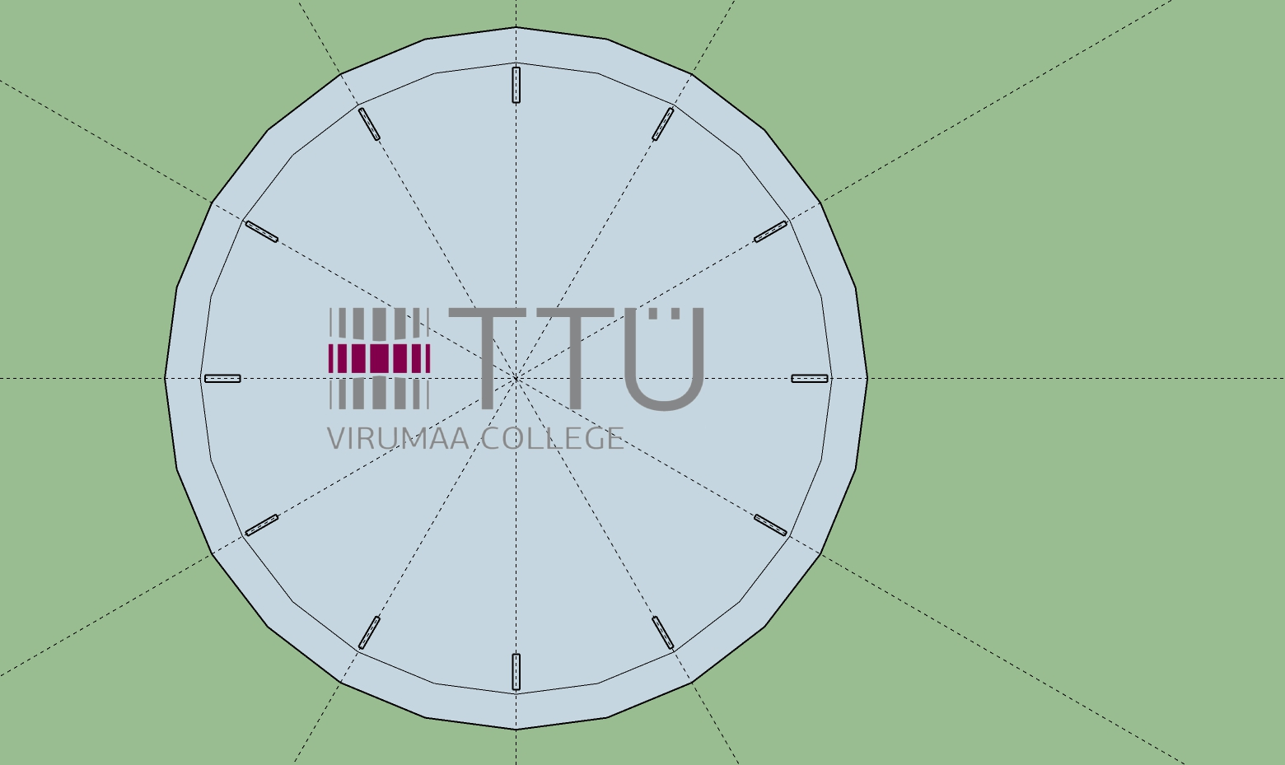
Notes:
Import logo picture and place it accordingly.

Slide 9
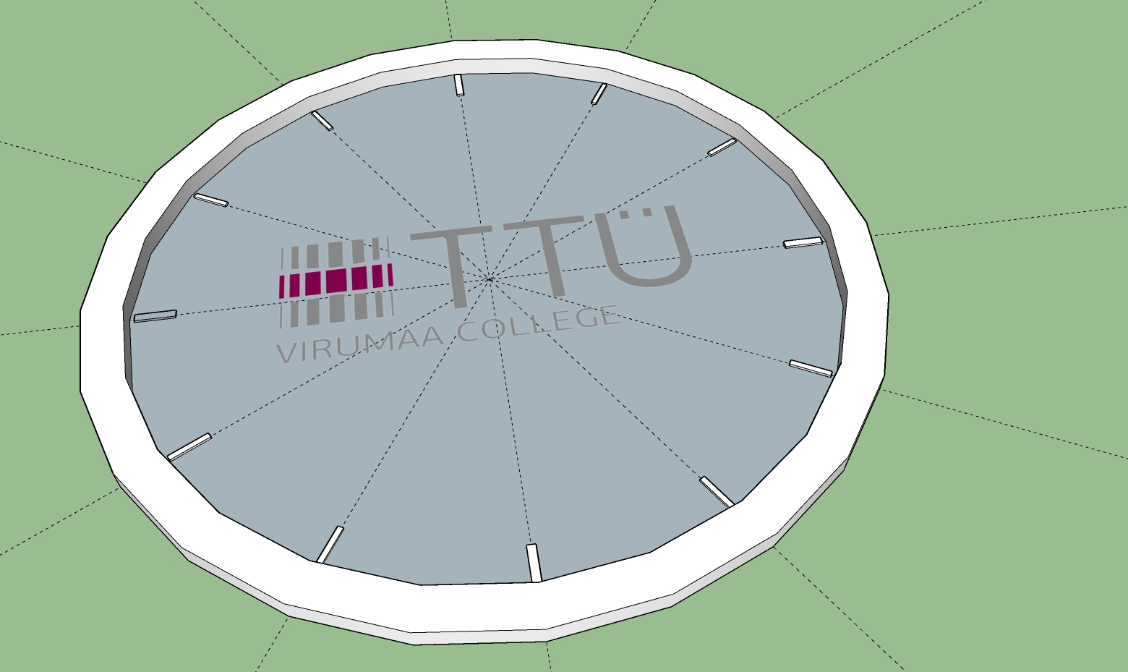
Notes:
Switch Camera to isometric view. Pull offset by 0,8 cm, and clock faces by 0,1 cm.

Slide 10
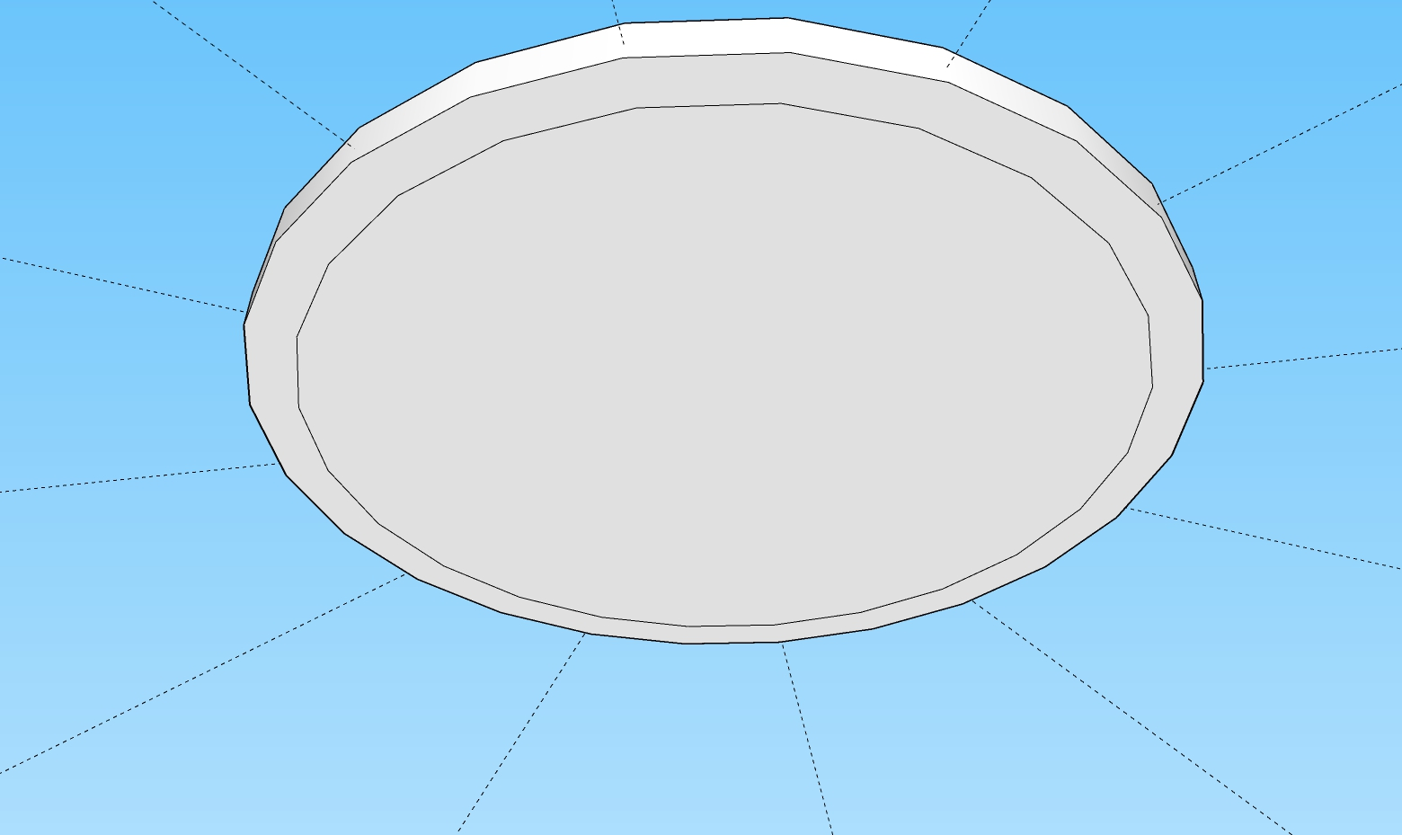
Notes:
Pull back of clock by 0,5 cm. Erase inner lines.

Slide 11
Notes:
Color faces with TTU colors. Erase guides. Add hour hands.

