Slide 1
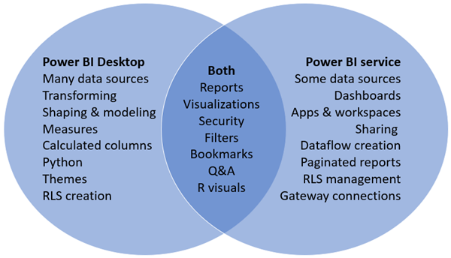
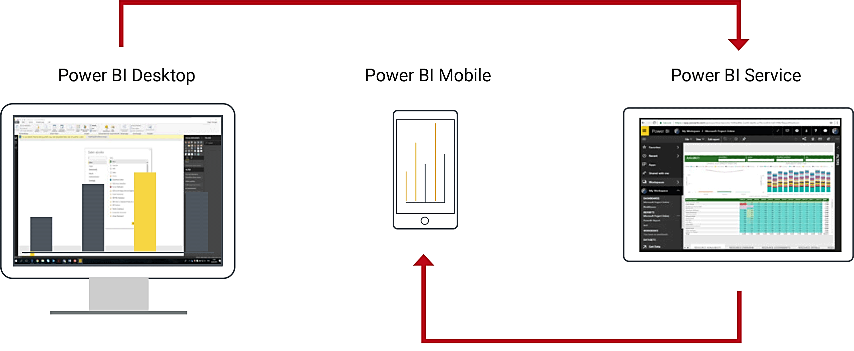
Andmete visualiseerimine Power BI abil (osa 1)
Power BI komponendid
Power BI Desktop - tasuta töövahend andmete kokku toomiseks, puhastamiseks ja teisendamiseks, seoste loomiseks ja aruannete kujundamiseks
Power BI service (pilveteenus)
Power BI Mobile Apps (Windows, iOS, Android )

Slide 2
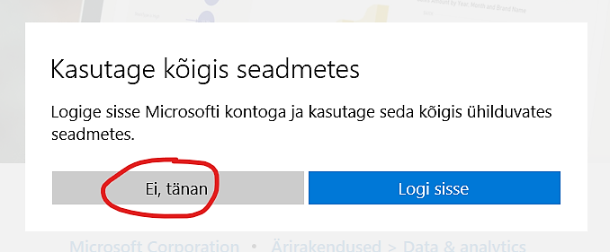
Power BI Desktop
Allalaadimine (64-bit, English, last version)
https://www.microsoft.com/en-us/download/details.aspx?id=58494
Jätke sisseloogimist vahele
Power BI hinnad
Power BI free vs Pro vs Premium
https://powerbi.microsoft.com/en-us/pricing/
https://docs.microsoft.com/en-us/power-bi/fundamentals/service-features-license-type

Slide 3
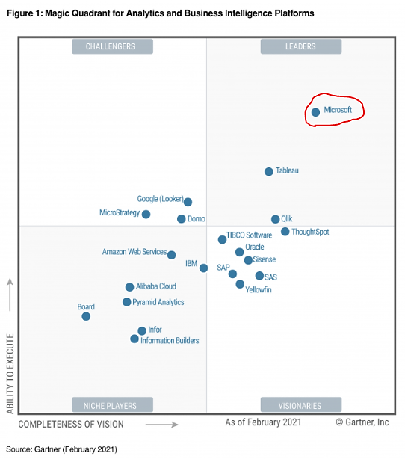
BI platforms
https://trends.google.com/trends/
https://www.sisense.com/

Slide 4
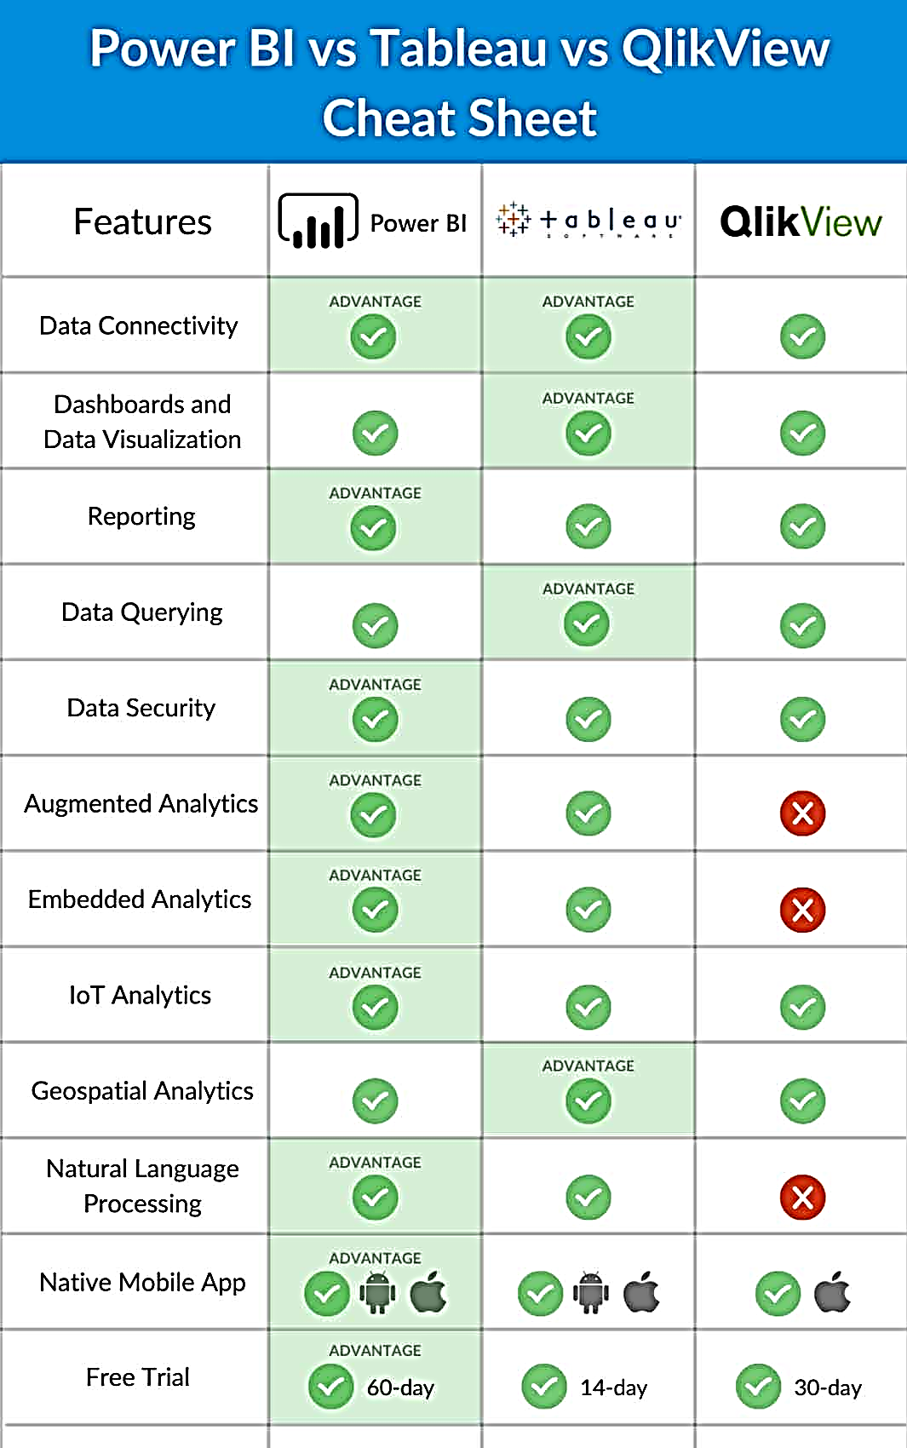
Power BI vs Tableau vs Google Data Studio vs QlikView

Slide 5
Power BI vs Tableau
https://www.tableau.com/academic/students

Slide 6
Tableau for Teaching

Slide 7
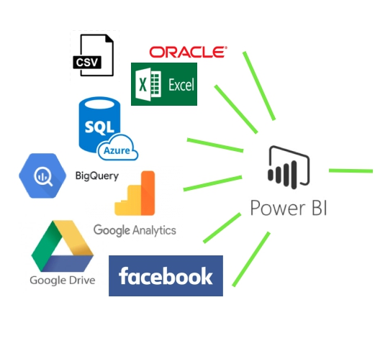
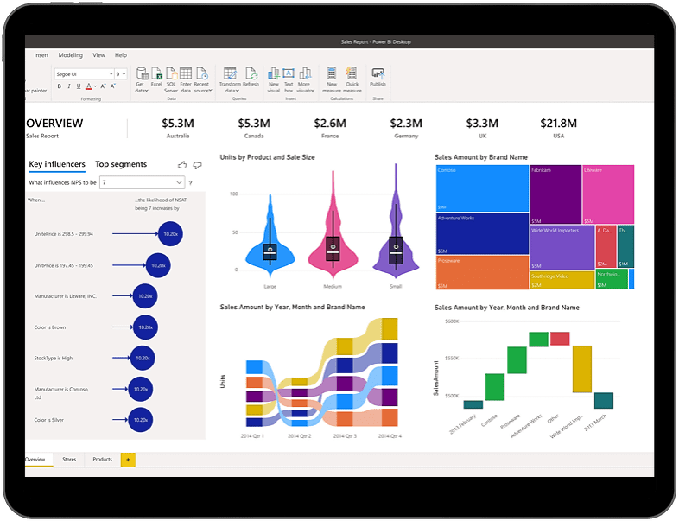
Power BI workflow
Andmete konsolideerimine
Andmete modelleerimine
Andmete visualiseerimine

Slide 8
Power BI: andmete ettevalmistamine 80% + visualiseerimine 20%
M keel
M formula language
DAX keel
Data Analysis Expressions (DAX)
Extract, Transform, Load

Slide 9
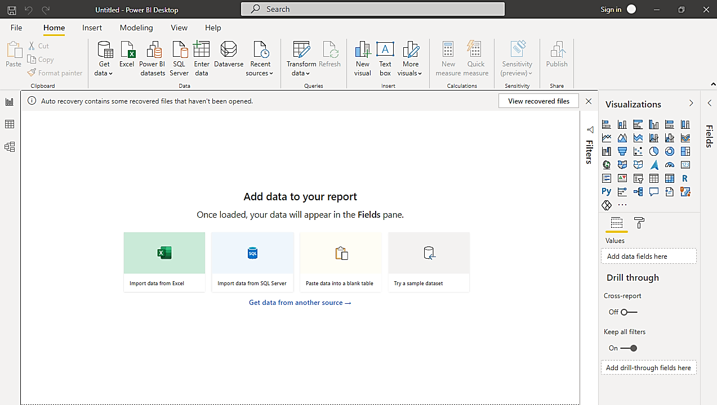
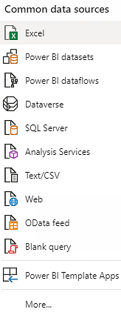
Power BI Desktop
visualiseerimine
konsolideerimine
modelleerimine
Näide:
Ilmaandmed
https://www.ilmateenistus.ee/ilm/ilmavaatlused/vaatlusandmed/tunniandmed//

Slide 10
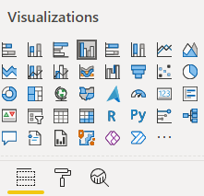
Power BI Desktop: visualiseerimise põhivõtmed
Aruande komplekteerimine:
lehekülgede kaupa vastavalt püstitatud küsimustele, hüpoteesidele
Ühel leheküljel on mitu graafikut, üks lehekülg – üks lugu (teesis, slaid, hüpoteesi kontroll).
Visualisatsiooni seadistamine:
sobiva visualisatsiooni valimine (sõltuvalt eesmärgist ja andmete tüüpidest)
visualisatsiooni struktureerimine (väljad ehk Fields)
vormindamine (kujundamine, Format)
andmete sortimine
lisaelementide lisamine.

Slide 11
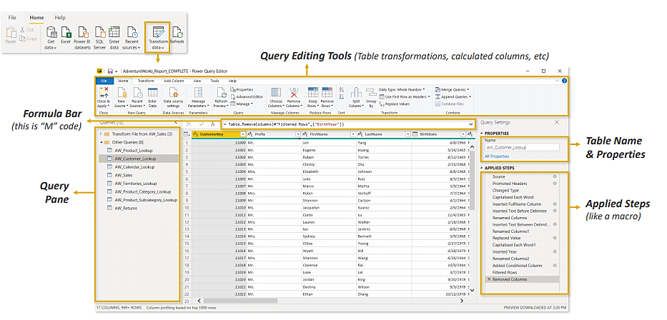
Power BI: Power Query Editor
Power Query in Power BI = Power Query in Excel

Slide 12
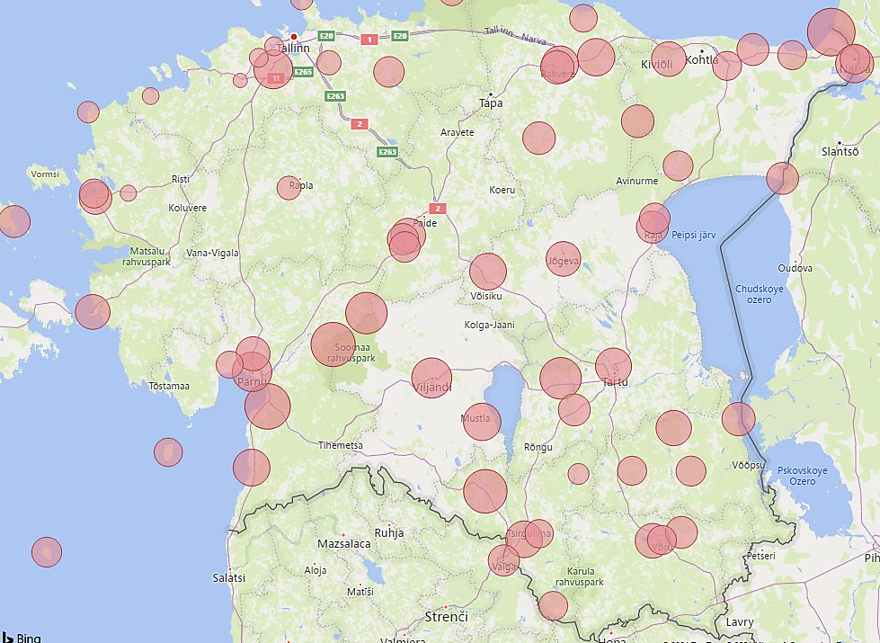
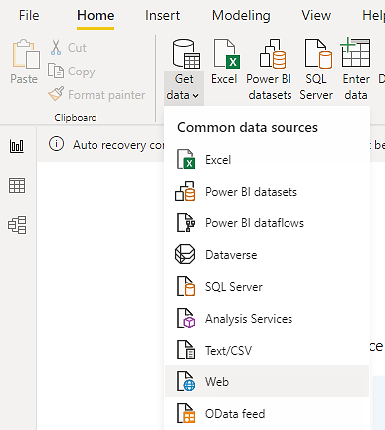
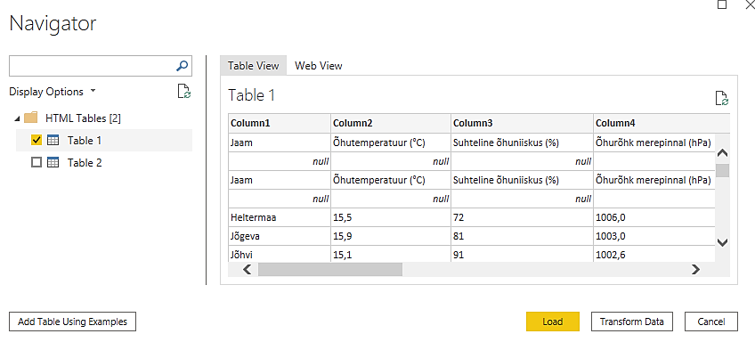
Power Query Editor: näide
Ülesanne:
laadida ilmaandmed
ettevalmistada Power Query Editory abil
visualiseerida õhutemperatuurid geograafilisel kaardil
https://www.ilmateenistus.ee/ilm/ilmavaatlused/vaatlusandmed/tunniandmed/

Slide 13
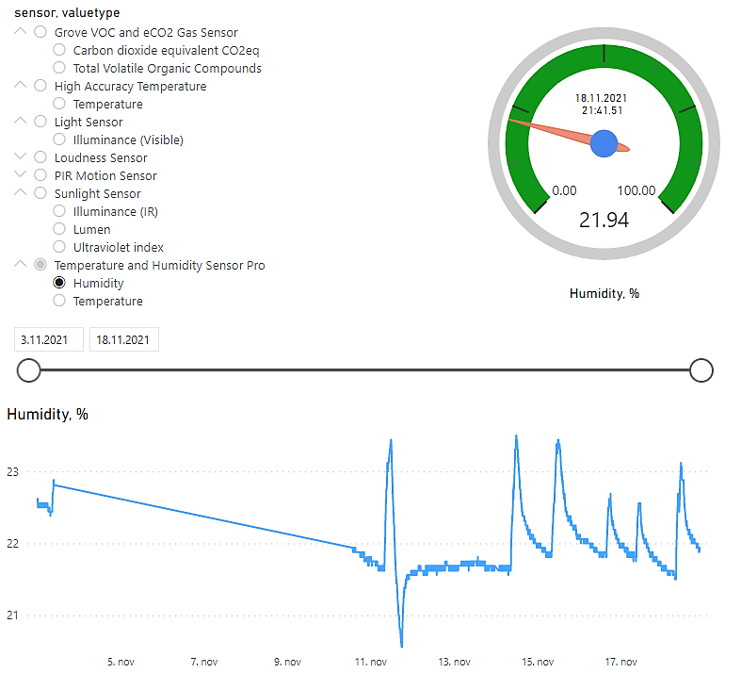
Ülesanne: PostgreSQL andmebaasi andmete visualiseerimine
Loome raporti Power BI Desktop abil ja jagame Power BI service abil

Slide 14
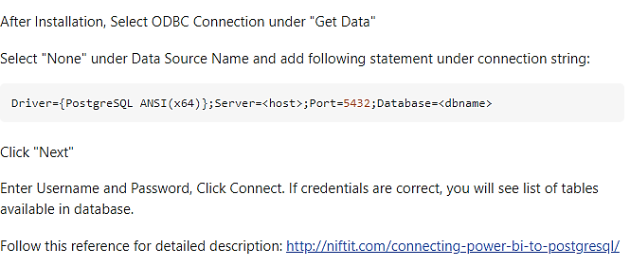
PostgreSQL andmebaasiga ühendamine
https://stackoverflow.com/questions/53921336/an-error-happened-while-reading-data-from-the-provider-the-remote-certificate-i/60451432
https://www.postgresql.org/ftp/odbc/versions/msi/
http://niftit.com/connecting-power-bi-to-postgresql/

Slide 15
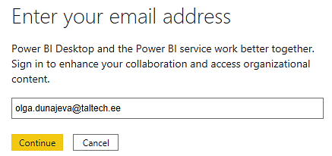
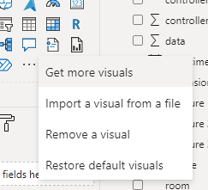
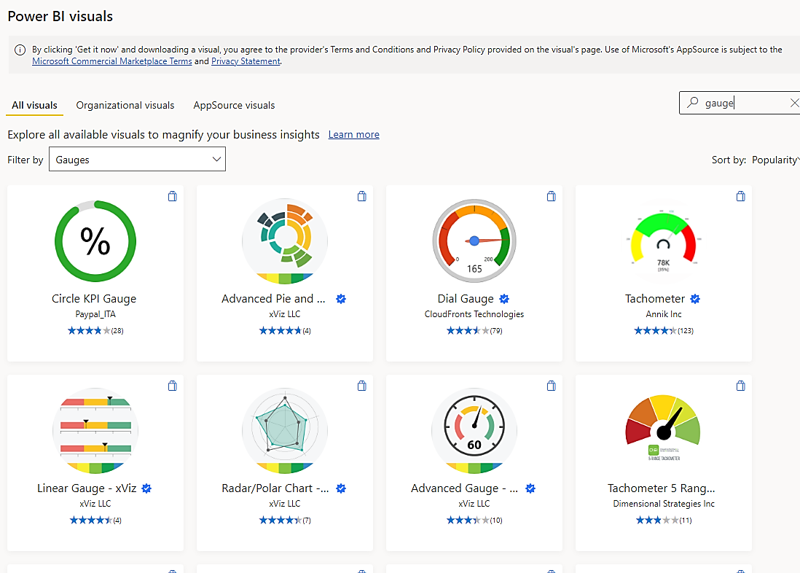
Power BI: Get more visuals
Nõuab ülikooli e-postiga sisselogimist

Slide 16
Andmete modelleerimine: DAX süntaks

Slide 17
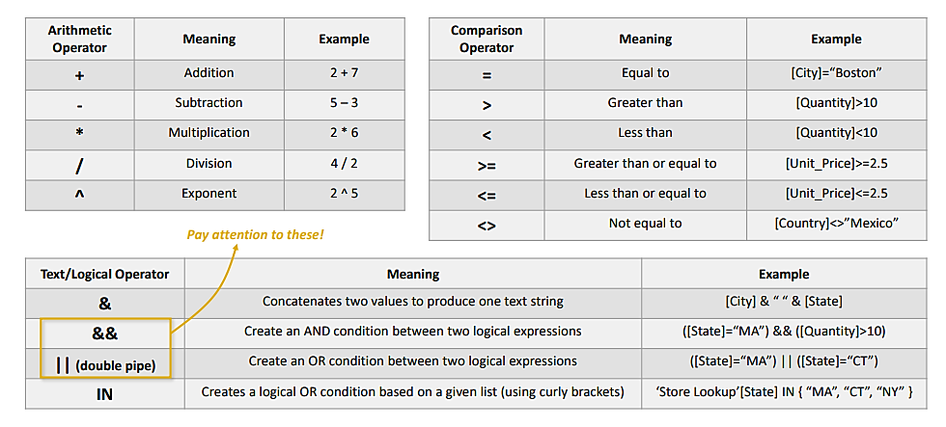
Andmete modelleerimine: DAX operaatorid

Slide 18
Andmete modelleerimine: DAX põhilised funktsioonid

Slide 19
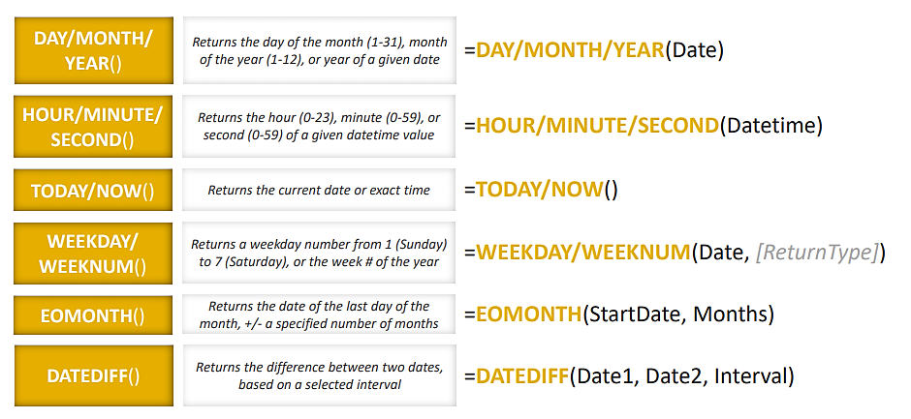
Andmete modelleerimine: DATE & TIME

Slide 20
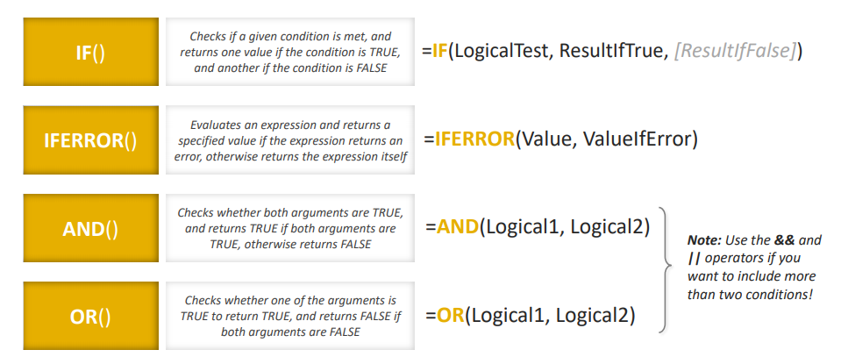
Andmete modelleerimine: loogilika funktsioonid

Slide 21
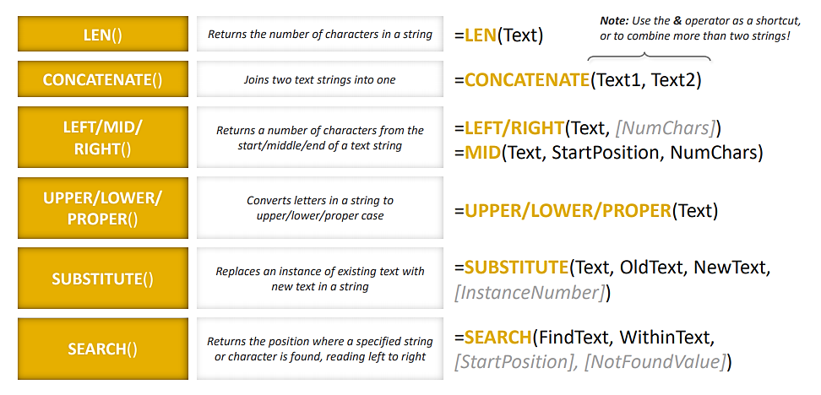
Andmete modelleerimine: tekstifunktsioonid

Slide 22
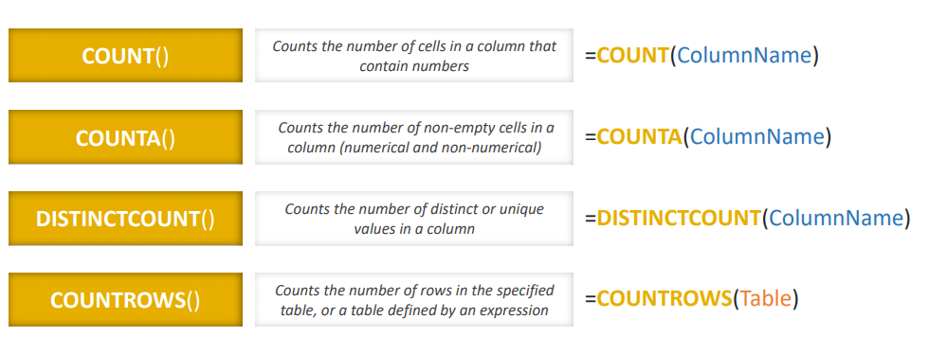
Andmete modelleerimine: related
Tagastab tabeli iga rea väärtused põhinides teiste tabelitega seostele

Slide 23
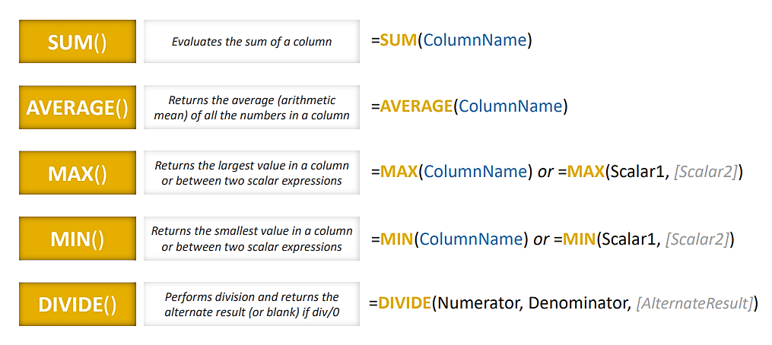
Andmete modelleerimine: matemaatika ja statistika

Slide 24
Andmete modelleerimine: calculate
Arvutab avaldise põhinedes valitud filtritele

Slide 25
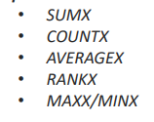
Andmete modelleerimine: ALL, FILTER, X
Puhastab filtritest
Seadistab filtreid
Rakendab funktsiooni tabeli ridadele

Slide 26
Andmete modelleerimine: ALL
https://docs.microsoft.com/en-us/dax/dax-function-reference/

Slide 27
Mõõdikud näiduki (gauge) loomiseks:

Slide 28
Raporti Power BI desktopist publitseerimine:

Slide 29
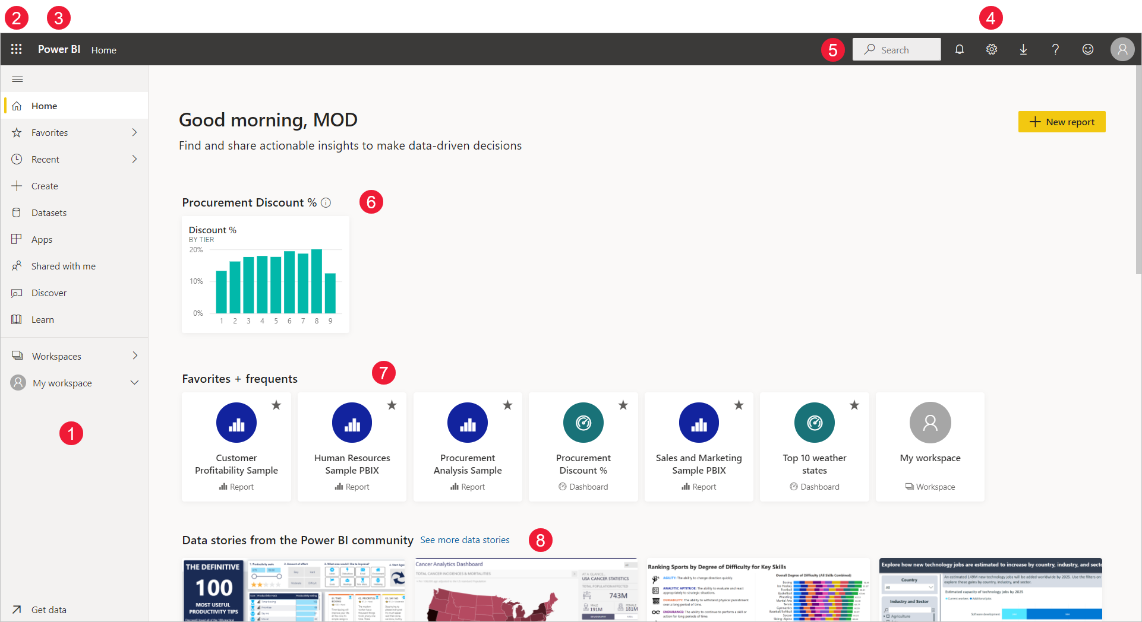
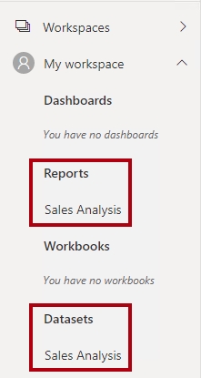
Power BI service: Home screen
Navigation pane
Microsoft 365 app launcher
Power BI home button
Icon buttons, including settings, help, and feedback
Search box
Favorited dashboards that you use the most
Favorite and frequent dashboards, reports and workspaces
Reports built by the Power BI Community, picked by the Power BI team

Slide 30
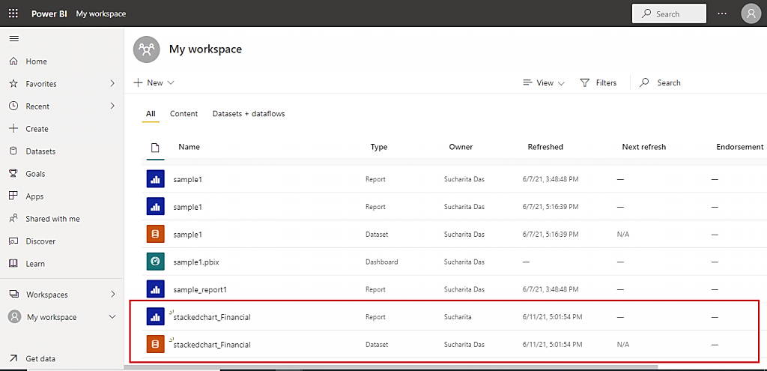
Power BI service
Pärast raporti Power BI service´is publitseerimist failist eraldatakse Report ja Dataset

Slide 31
Power BI service: My workspace and workspaces

Slide 32
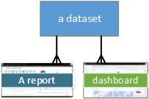
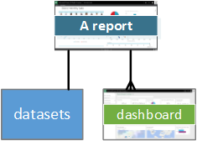
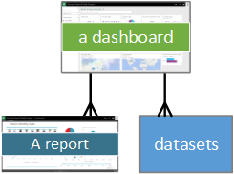
Power BI service: datasets, reports, dashboards
Dataset:
can be used in many workspaces
can be used in many reports
visualizations from that one dataset can display on many different dashboards.
Report:
is contained in a single workspace
can be associated with multiple dashboards within that workspace
uses data from one dataset (Power BI Desktop can combine more than one data source into a single dataset in a report).
Dashboard:
is associated with a single workspace
can display visualizations from many different datasets
can display visualizations from many different reports
can display visualizations pinned from other tools (for example, Excel)

Slide 33
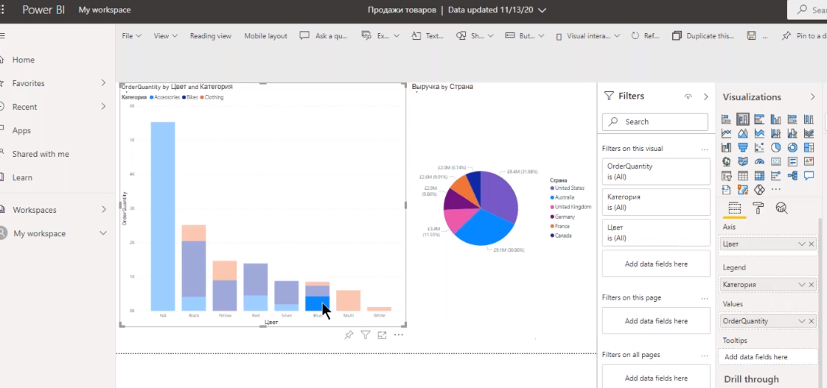
Raporti redigeerimine: edit mode

Slide 34
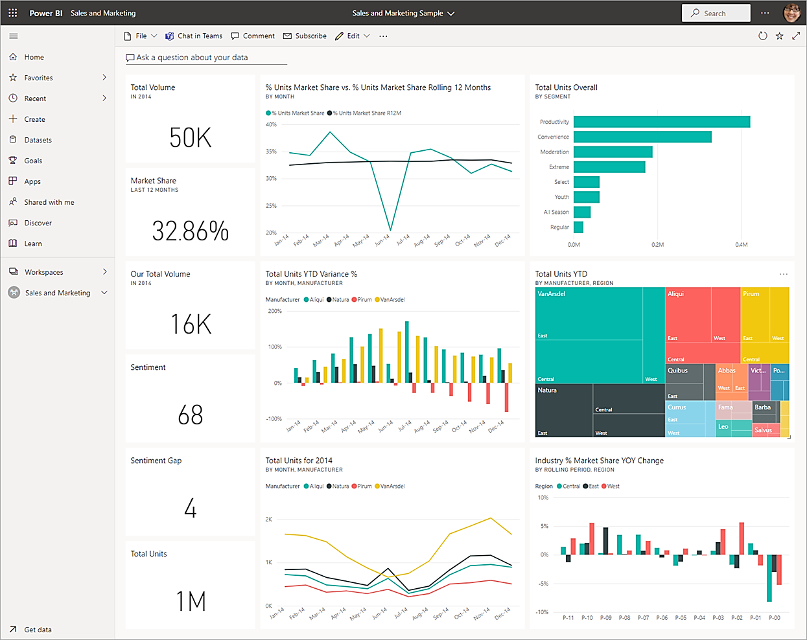
Dashboardi loomine
https://docs.microsoft.com/en-us/power-bi/consumer/end-user-dashboards
A Power BI dashboard is a single page, often called a canvas, that uses visualizations to tell a story. Because it is limited to one page, a well-designed dashboard contains only the most-important elements of that story.
The visualizations you see on the dashboard are called tiles and are pinned to the dashboard by report designers. In most cases, selecting a tile takes you to the report page where the visualization was created. If you're new to Power BI, you can get a good foundation by reading Power BI basic concepts.

Slide 35
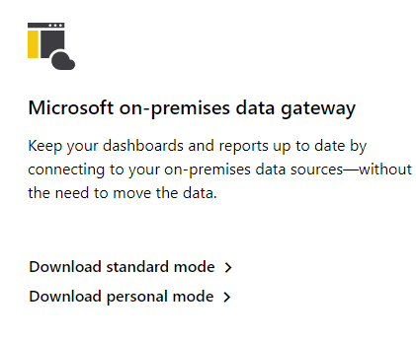
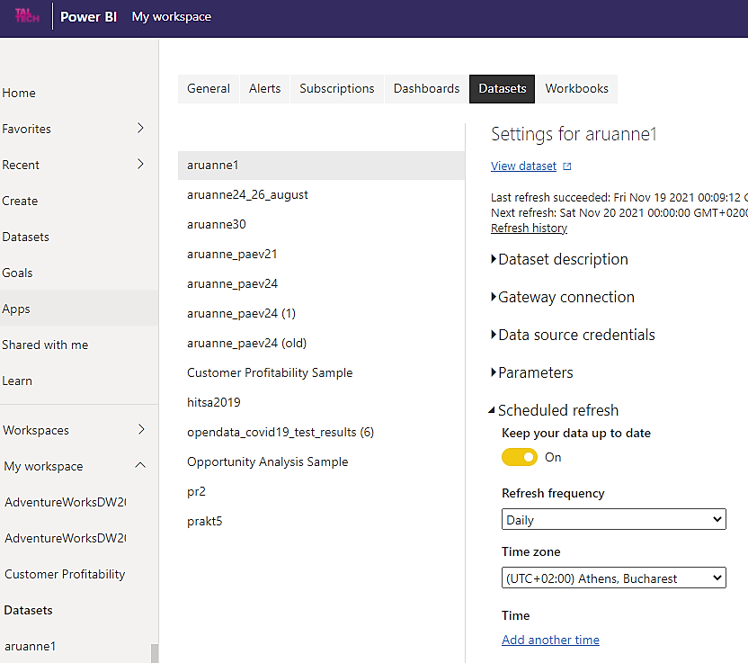
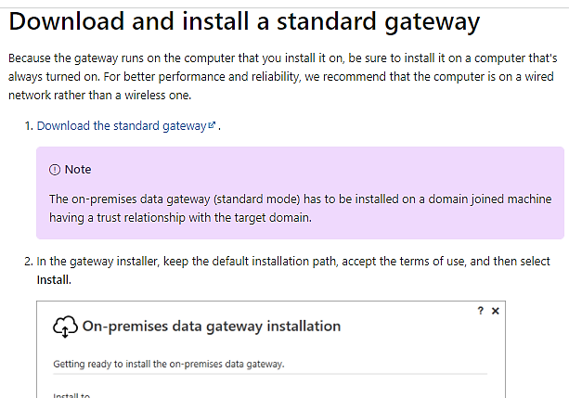
Raporti värskendamine:
https://docs.microsoft.com/en-us/data-integration/gateway/service-gateway-install

Slide 36
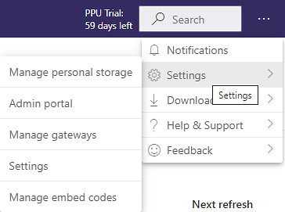
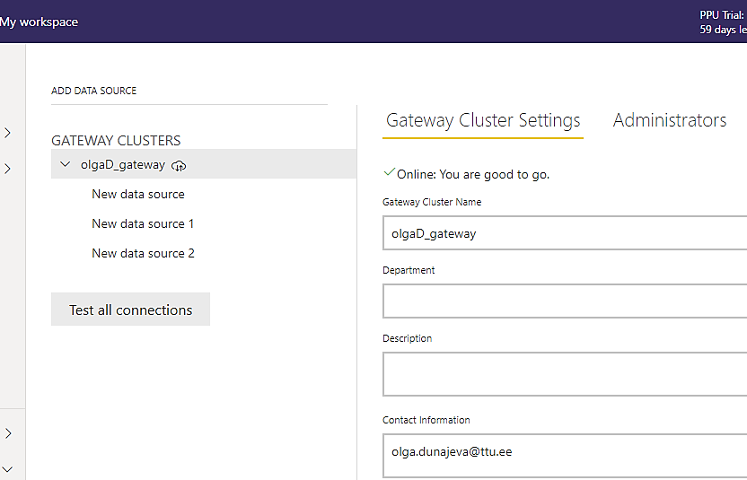
Manage an on-premises data gateway:
https://docs.microsoft.com/en-us/data-integration/gateway/service-gateway-manage

Slide 37
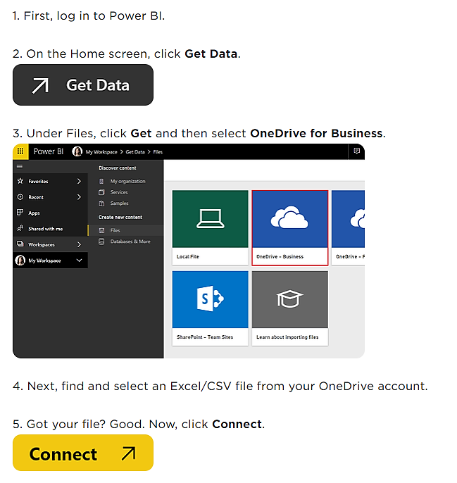
Refresh a dataset stored on OneDrive :
https://docs.microsoft.com/en-us/power-bi/connect-data/refresh-desktop-file-onedrive
Importing and connecting OneDrive files to Power BI:
https://www.brainstorminc.com/blog/onedrive-files-to-microsoft-powerbi

Slide 38
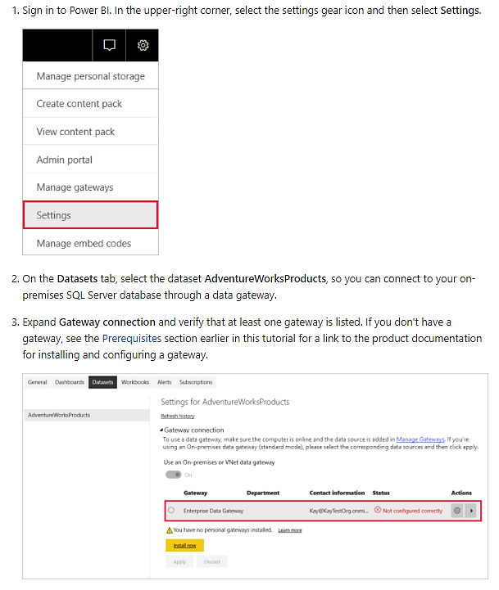
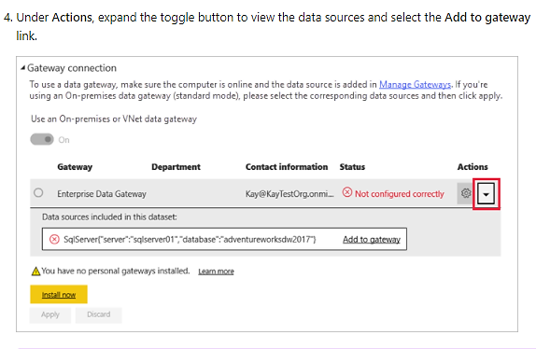
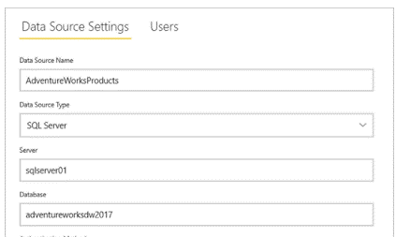
Refresh data from an on-premises SQL Server database:
https://docs.microsoft.com/en-us/power-bi/connect-data/service-gateway-sql-tutorial

