Slide 1
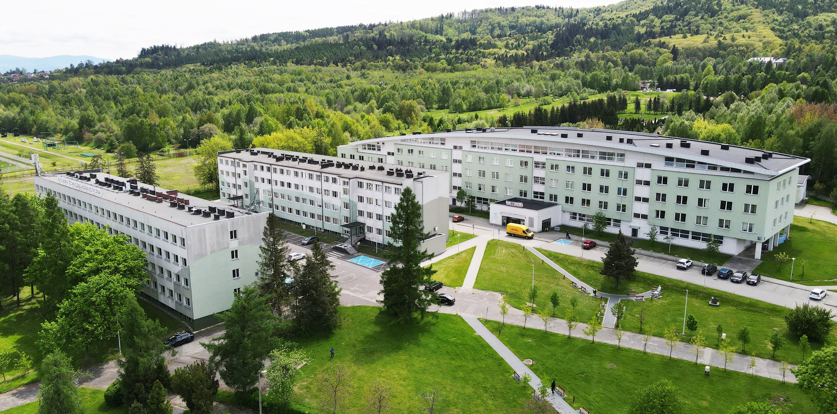
www.ubb.edu.pl/en
University of Bielsko-Biala
Close. Practical. With passion!
Summer internship camp

Slide 2
Organised within Erasmus+ Programme
Summer intern camp
17th June – 18th September 2024
Number of ECTS points: 7
www.ubb.edu.pl
2

Slide 3
Language module
Modules
Communication module
Practical side – excursions in local and regional companies
Specialist module
www.ubb.edu.pl
3

Slide 4
Language module
30 hours of Polish language course
Language module
30 hours of English specialist, technical language course
www.ubb.edu.pl
4

Slide 5
Management and Interpersonal module
15 hours of communication skills workshops
Raising skills
15 hours of management skills (CSR, Human resources management skills) responsibility
CSR- corporate social responsibility
www.ubb.edu.pl
5

Slide 6
Specialist module, which corresponds to the area of study
Specialist module
60 hours of lectures and laboratories each block
Mechanical engineering
Environmental engineering
inuction
www.ubb.edu.pl
6

Slide 7
17th – 21st of June orientation days
24th of June to 16th of August – workshops and laboratories
Schedule
19th of August – 16th of September individual project
17th of September - final project presentations
18th of September - official closing ceremony
www.ubb.edu.pl
7

Slide 8
Andrzej Urbas PhD
Erasmus+ Faculty Coordinator
E-mail: aurbas@ubb.edu.pl
Contact details
Prof. Mariusz Kuglarz
Erasmus+ Faculty Coordinator
E-mail: mkuglarz@ubb.edu.pl
Dagmara Mika PhD
Institutional Coordinator for Internships and Education Advisory
E-mail: dmika@ubb.edu.pl
www.ubb.edu.pl
8

